Slide 1
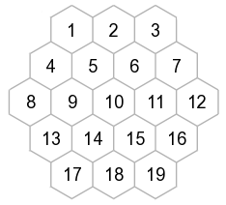

Slide 2
1
2
3
4
5
6
7
S
M
B
S
M
B
S
M
B
8
9
10
11
S
M
B
S
M
B
S
M
B
12
13
14
15
16
17
18

Slide 3
1
2
3
S
M
M
4
5
6
7
B
B
M
S
8
9
10
11
S
S
M
B
12
13
14
15
M
B
S
B
16
17
18
M
S
B

Slide 4
1
2
3
S
M
4
5
6
7
B
M
B
S
8
9
10
11
S
B
B
12
13
14
15
M
S
S
16
17
18
B
M

Slide 5
1
2
3
S
M
4
5
6
7
B
M
B
S
8
9
10
11
S
B
B
12
13
14
15
M
S
S
16
17
18
B
M

Slide 6
1
2
3
M
M
4
5
6
7
B
B
S
8
9
10
11
S
B
B
12
13
14
15
M
S
S
16
17
18
B
M

Slide 7
1
2
3
M
M
4
5
6
7
B
S
8
9
10
11
B
B
12
13
14
15
S
16
17
18

Slide 8
1
2
3
M
M
4
5
6
7
B
S
8
9
10
11
BLUE PLAYER WINS!
B
B
12
13
14
15
16
17
18

